Slide 1
Intel® AI For Workforce
Module 29 – AI Ethics
Version: Vocational
Notes:
In this session will shall discuss in depth about AI Ethics and learn to apply it through another canvas we can use to help us.

Slide 2
Agenda
What is AI Ethics?
AI Ethics Canvas
Notes:
In this session, we shall go in depth about AI Ethics, we will first recap some of the examples we have seen about AI Ethics such as AI for good, AI Bias and inclusion. We will then learn about the 6 principles of AI Ethics and gain an understanding of the various factors to consider about AI solutions and finally put what we have learned into action through a group activity involving going through two web-based AI Ethics games and mapping the issues found against the AI Ethics Canvas.

Slide 3
What is AI Ethics?
Notes:
To start with, is anybody familiar with AI Ethics? Do you recall hearing about some of these terms like AI Bias and Inclusion? Well today we shall learn more about it.

Slide 4
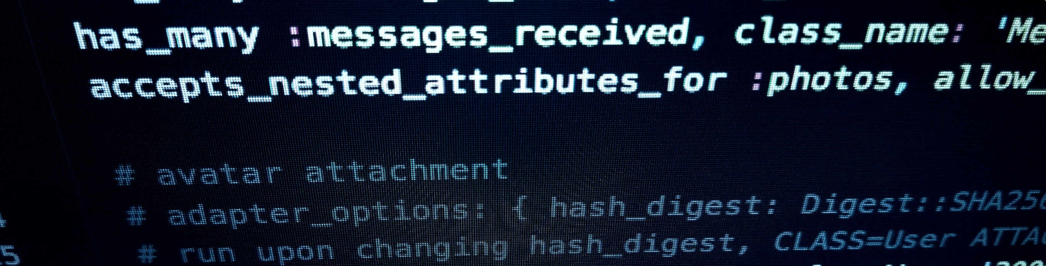
What is AI Ethics?
Do you recall these?
AI for Good
AI Bias
AI Inclusion
Notes:
In previous sessions you might have recalled that we talked a little about AI Ethics, we shall do a brief recap of those.

Slide 5
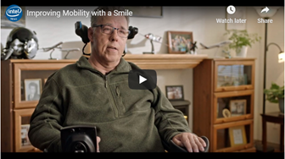
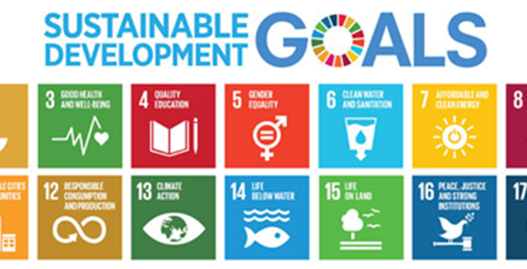
AI for Good
Remember these?
How AI Empowers people
Sustainable Development Goals
Intel: Improving Mobility with a Smile
Sustainable Development Goals
Intel Newsroom. (2019, June 4). Improving Mobility With a Smile [Video]. YouTube. https://youtu.be/6jNL601th0Y
Notes:
Remember earlier in the course we watched this video about how AI can help empower people’s lives? We also covered a little about SDGs and how we could use AI to benefit some community in the midst of a large problem. These are the kind of examples of AI for good where it can be used to improve lives and go toward the betterment of people.

Slide 6

AI Bias
And these?
How a Chatbot learned bad behavior
How AI penalized female applicants?
Facial recognition false positives?
Notes:
We have talked a little about these back in Design Thinking, do you remember why we are interested in AI bias very early in the AI project cycle?

Slide 7

AI Inclusion
To reiterate
Accessibility
Fairness
Notes:
We also talked about inclusion earlier on, we were then focused on AI being available for everyone to use or build, also a little about fairness in the sense that AI should not ultimately benefit to another’s detriment.

Slide 8
AI Ethics, is that it?
There’s more to discuss!
Notes:
These are just some aspect of AI ethics we have covered previously. In this session, we shall learn more about the other areas to consider when describing AI Ethics. We can have a more in-depth examination of AI Ethics with an AI Canvas. We will use this Canvas to help us list down and describe in more detail about some of the things to consider when thinking about designing or implementing an AI solution.

Slide 9
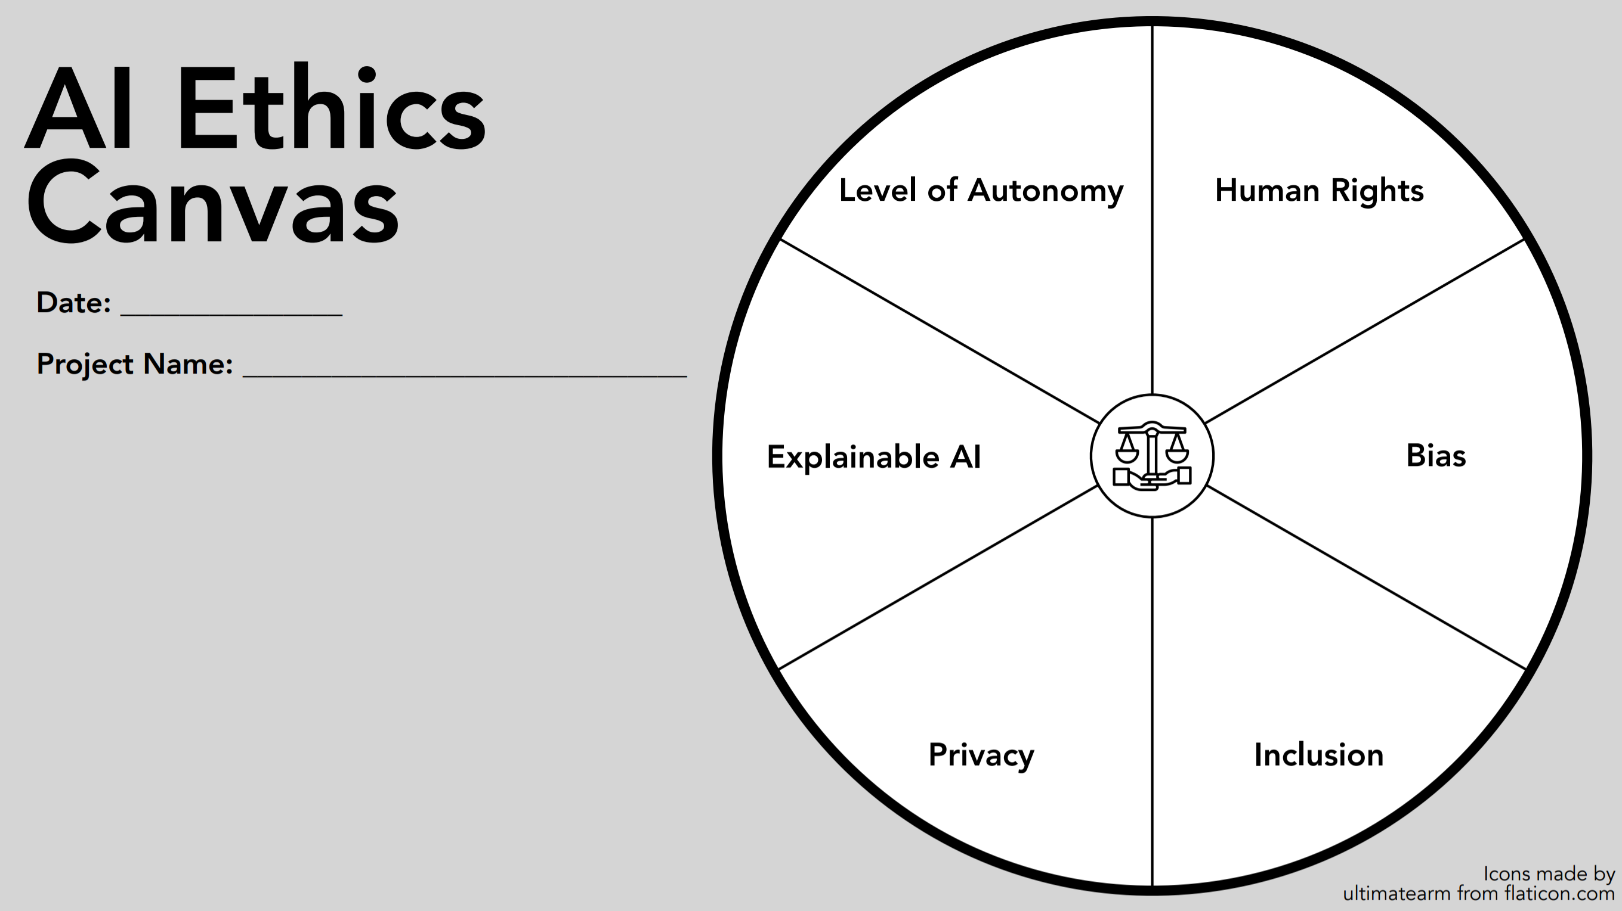
Notes:
In this diagram, you can see six principles of AI ethics inside the AI Canvas wheel. These are the 6 Principles of AI Ethics we have identified.
Human Rights.
Bias.
Inclusion.
Privacy.
Explainable AI
Level of autonomy.
The purpose of the AI canvas is to evaluate and note down in what way will your AI affect people. To identify to what extent the impact of your AI, we shall go through step by step through each slice of the canvas. By asking a few relevant questions, we can identify the ramifications of any proposed AI solution.

Slide 10
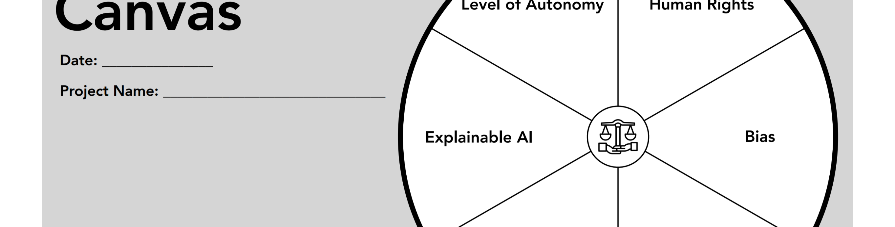
AI Ethic Canvas
Human Rights
Bias
Inclusion
Privacy
Explainable use of AI
Level of Autonomy
Notes:
These are the 6 AI ethical principles we will use to guide us while we consider designing and implementing AI solutions.

Slide 11
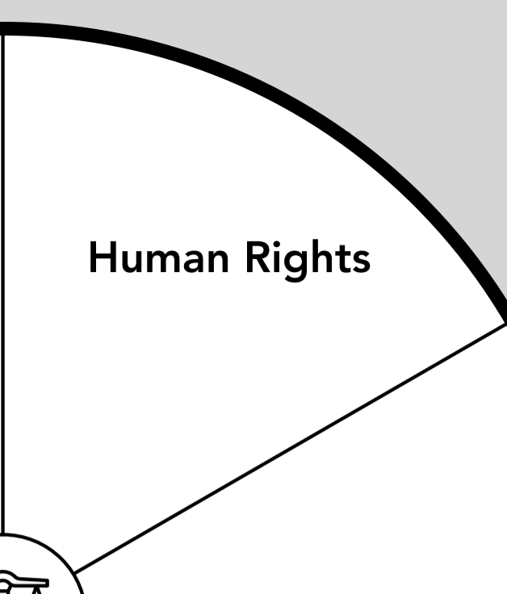
Human Rights
Some Examples
Does your AI take away Freedom?
Does your AI discriminate against People?
Does your AI deprive people of jobs?
Use UN’s Declaration of Human Rights
Notes:
Starting with Human Rights, here are some starting questions you could ask: Does your AI take away someone’s freedom? Freedom being in the broad spectrum that could start with freedom of speech, freedom of thought, freedom to religion, etc. Does your AI discriminate against a person or a demographic? AI should not decide for and act on without human intervention in some form, and does your AI deprive people of jobs? In the sense that if it’s usage would harm livelihoods instead of enhancing it and benefiting people. There are more concerns to infer, you could always refer to the UN’s Declaration of Human Rights for more detailed breakdowns of Human Rights.

Slide 12
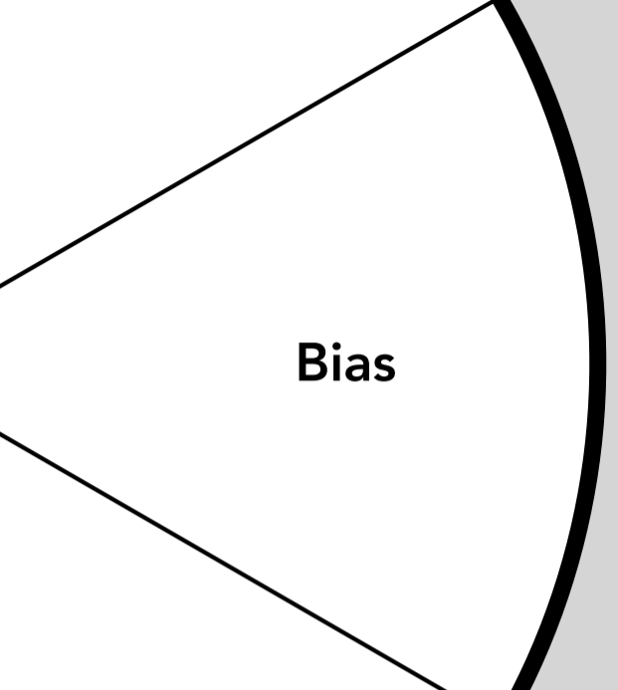
Bias
Some Examples
Is your Dataset equally representative of the population?
Will your AI learn to discriminate against certain groups of people?
Does your AI exclude people?
Notes:
Bias, as we have talked about before can manifest even before you might begin developing an AI solution
Here is where you could list potential problems or give ideas to preemptively avoid bias from the outset.
Is your dataset equally representative of the population? Why does your dataset need to be equally representative of the population? For example, in a medical dataset, male patients might account for a large majority of the sample, this in turn could lead to female patients getting poor diagnosis from the over indexing of male symptoms.
Likewise, you need to ask if your AI will learn to discriminate against certain groups of people. For example if AI is used in the recruitment process, a biased AI might inherit unintended bias from bad datasets. Another example similarly discussed before, in using AI for facial recognition, If the samples are based on fair skin people to unlock access to a facility or building, people with darker skin would not be consistently recognized and refused entry more often.
Does your AI exclude people? Will your AI exclude people with physical disabilities? Will your AI exclude people with lower level of intelligence or of a “lower” social standing?

Slide 13
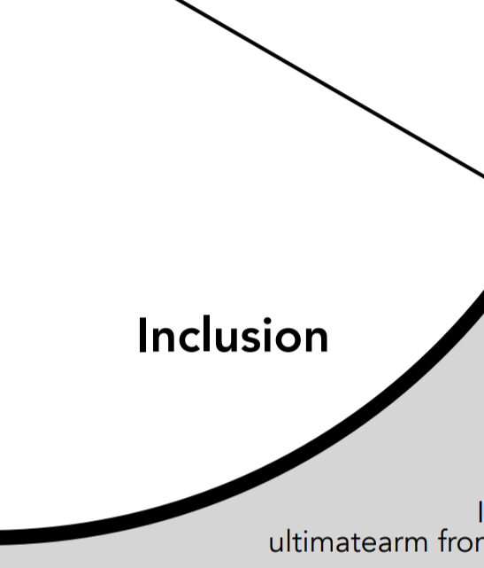
Inclusion
Some Examples
Does your AI alienate any person?
Who is more proportionately advantaged through your AI?
Does it affect the less fortunate?
How user-friendly is your AI?
Who does your AI empower?
Notes:
If you recall from Inclusive AI, we talked a little about Inclusion, here are more factors to consider, your AI should be fair, promote diversity and be averse disproportionately benefiting any one group of people to the detriment of another. These are some of the questions to ask for Inclusion
1. Does your AI alienate any person?
2. Who is more proportionately advantaged through your AI?
3. Does it affect the less fortunate?
4. How user-friendly is your AI?
5. Who does your AI empower?

Slide 14
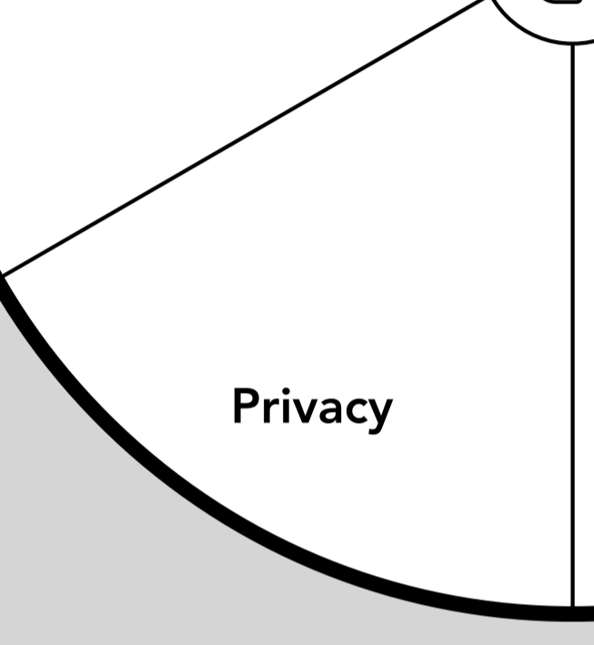
Privacy
Some Examples
Does your AI collect people’s data?
What does it do with the data?
Will your AI comply with consent?
Will your AI compromise a person’s Security?
How will your AI ensure a person’s safety?
Notes:
Let us look at the ethical issue of Privacy. As AI applications become more broadly used, it is inevitable that a person’s data might somehow be processed by AI in some form. The patterns found by machine learning analysis of your online behavior disclose private information, even if you have never revealed this information to anyone online. Remember, data are being collected each time you visit a webpage, post on Facebook, Instagram or Tik Tok, each time you swipe your credit card or open your email.
In such situations here are some of the questions that might arise.
Does your AI collect people’s data?
What does it do with the data collected?
Will your AI comply with consent?
Will your AI compromise a person’s Security?
How will your AI ensure a person’s safety?

Slide 15
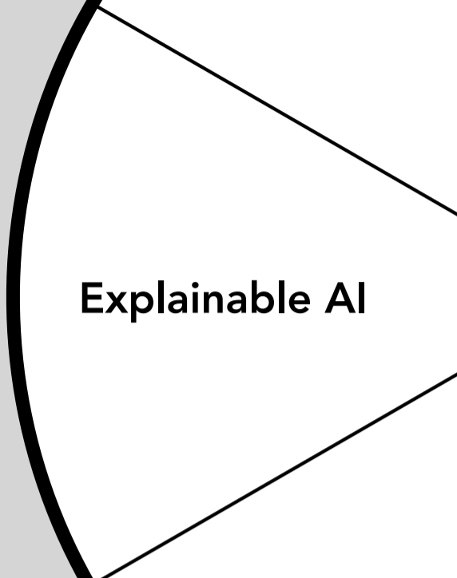
Explainable use of AI
Some Examples
Can your implementation be easily described?
Could you explain the entire process of your AI project cycle?
Can you justify AI enabled decision?
Notes:
In Explainable use of AI, AI tend to be shrouded in mystery and fosters distrust or appear opaque and complex. To that end, you should be able to distil your purpose for your solution to exist or be implemented and be able to take accountability for actions driven by the AI.
These are some of the questions you should consider:
1. Can your implementation be easily described?
2. Could you explain the entire process of your AI project cycle?
3. Can you justify AI enabled decision?
Why is this important?
Explainable use of AI lets humans understand and articulate how an AI system made a decision – This will be important especially in healthcare, manufacturing, insurance, and automobiles industries. Let us take the case of a recommended medical treatment or a rejected application for a mortgage loan. These are high-stakes scenarios and, particularly in the event of a negative outcome, an individual may need (and possibly be entitled to) clear explanations of how AI arrived at a particular result. In many cases, this will also apply to auditors, lawyers, government agencies, and other potential parties that uses AI to take over human decision making. As the responsibility for a particular decision or result shifts away from humans to machines, the need for explainability also rises.

Slide 16
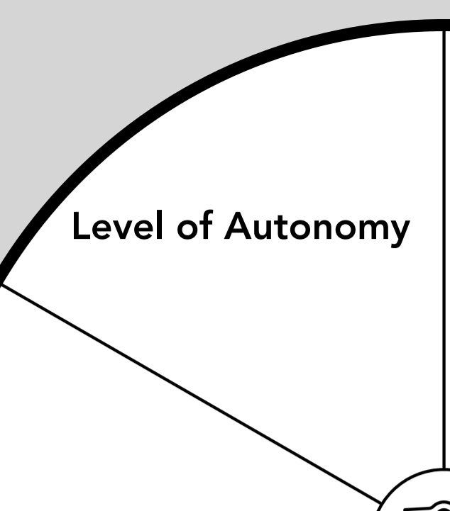
Level of Autonomy
Some Examples
Does your AI prevent people from interfering with it?
Does it require an overwrite to that end?
Will people be able to control your AI?
How does it handle morality?
Notes:
Lastly for Level of Autonomy, what is really means is that how many decisions can your AI make without people’s input? Here are factors to consider, take for example a self-driving car, how far will the car be able to operate without a person and/or does it take away control for a person? What about morality, does it deem a life less than another? How does it justify that?

Slide 17
How do you think AI ethics impacts you?
Following the AI Ethics Canvas, can you think of any situations?
Notes:
As an AI practitioner yourself, think along your fields of studies or interests, could you relate to a situation that can be reflected through the AI Ethics Canvas?

Slide 18
Notes:
Thank you for attending today’s session! I look forward to seeing you next time!

